Slide 1
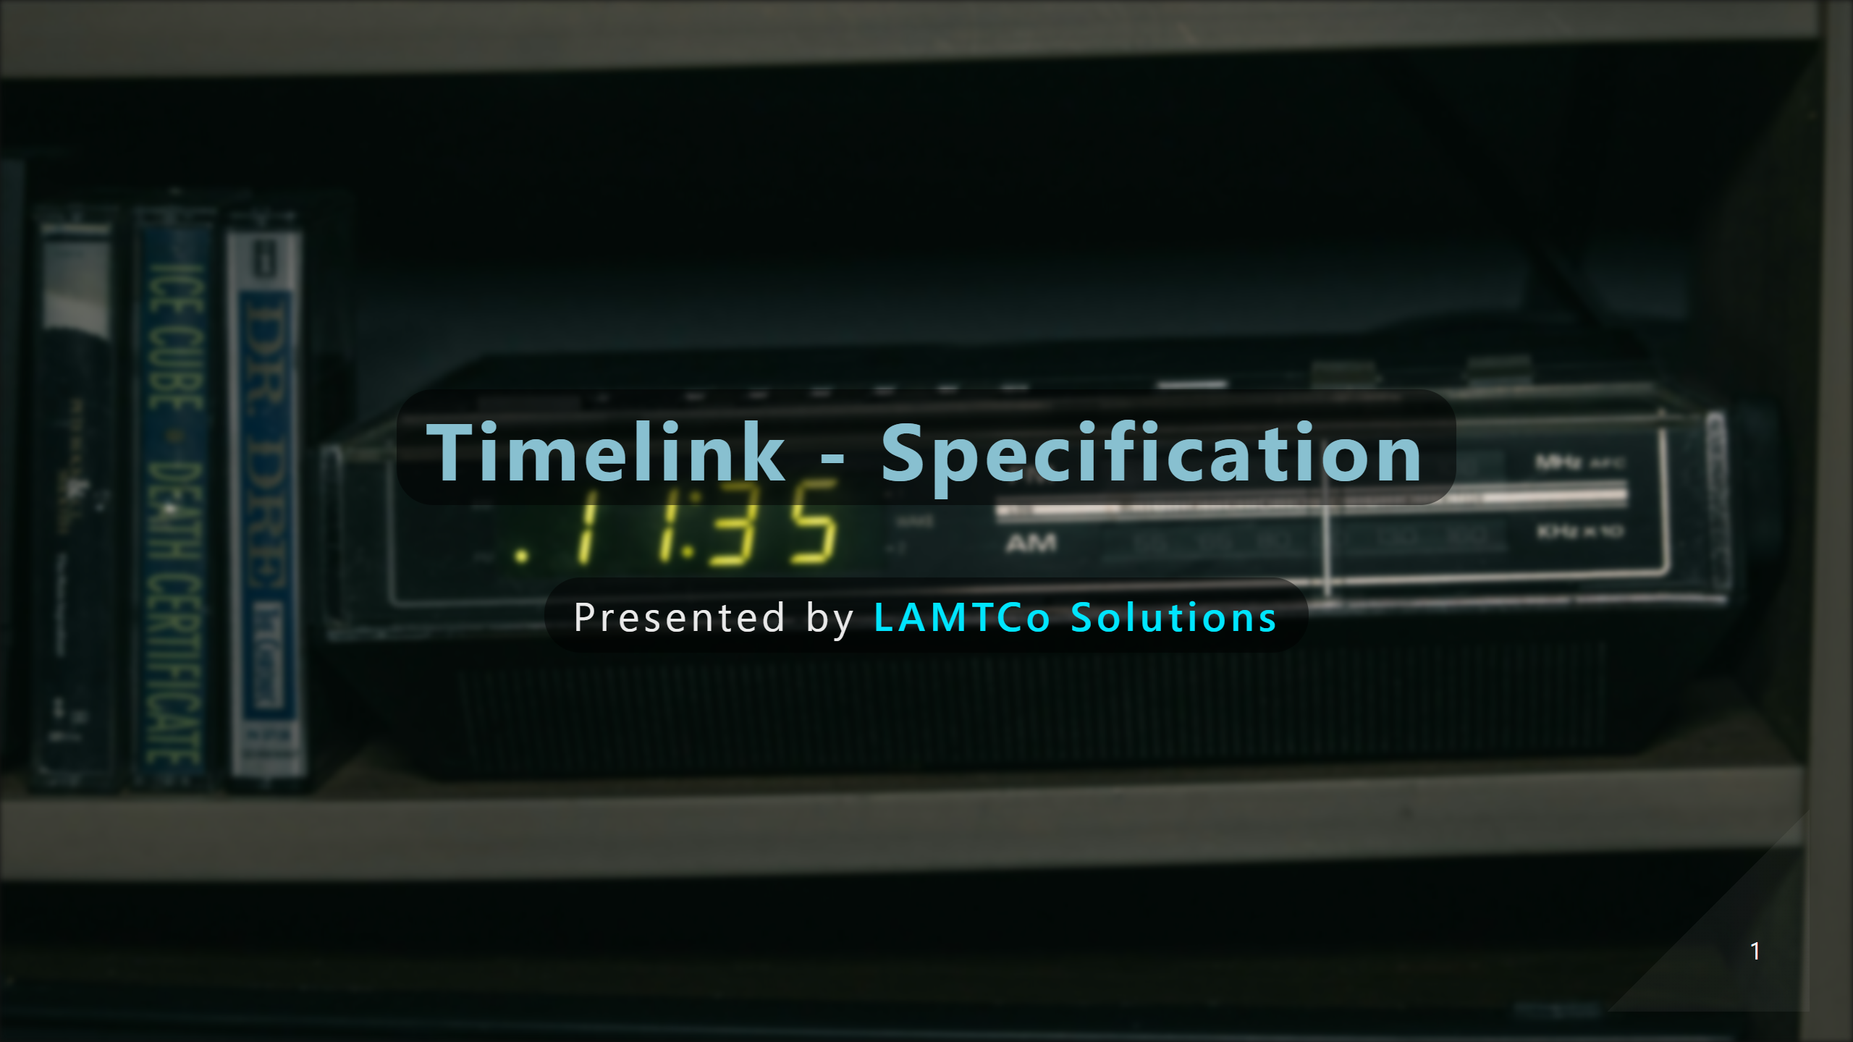
Notes:
Andre

Slide 2
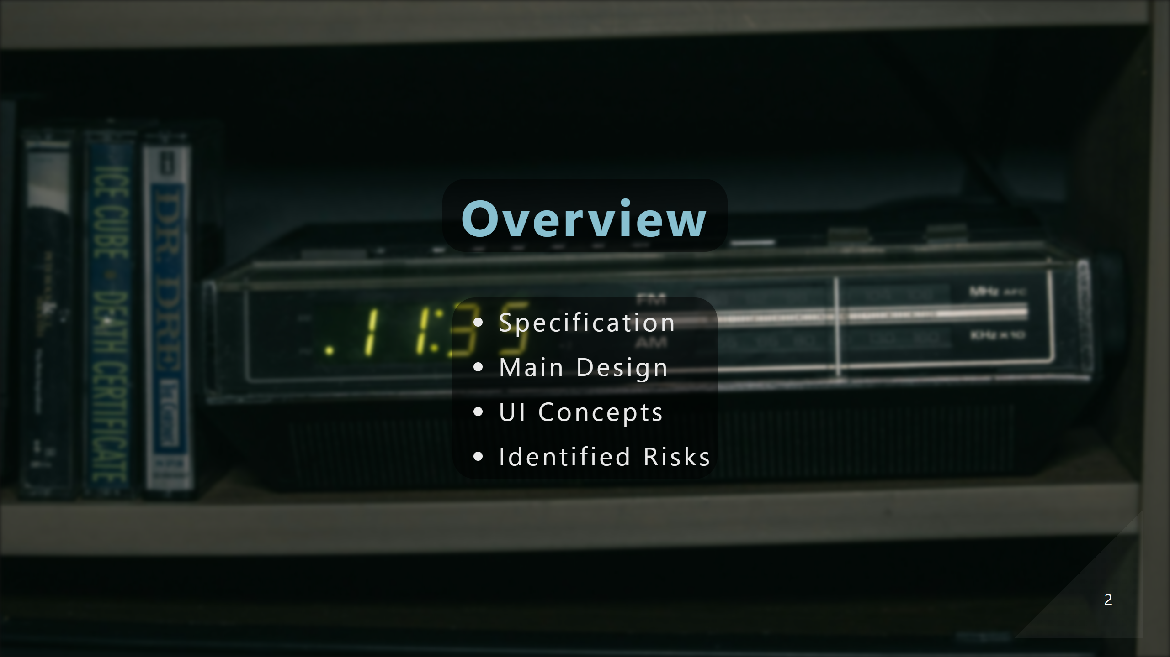
Notes:
Andre

Slide 3
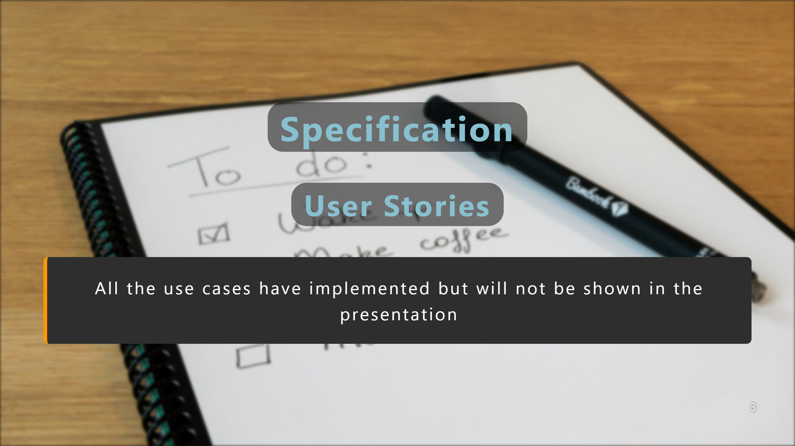
Notes:
Andre

Slide 4
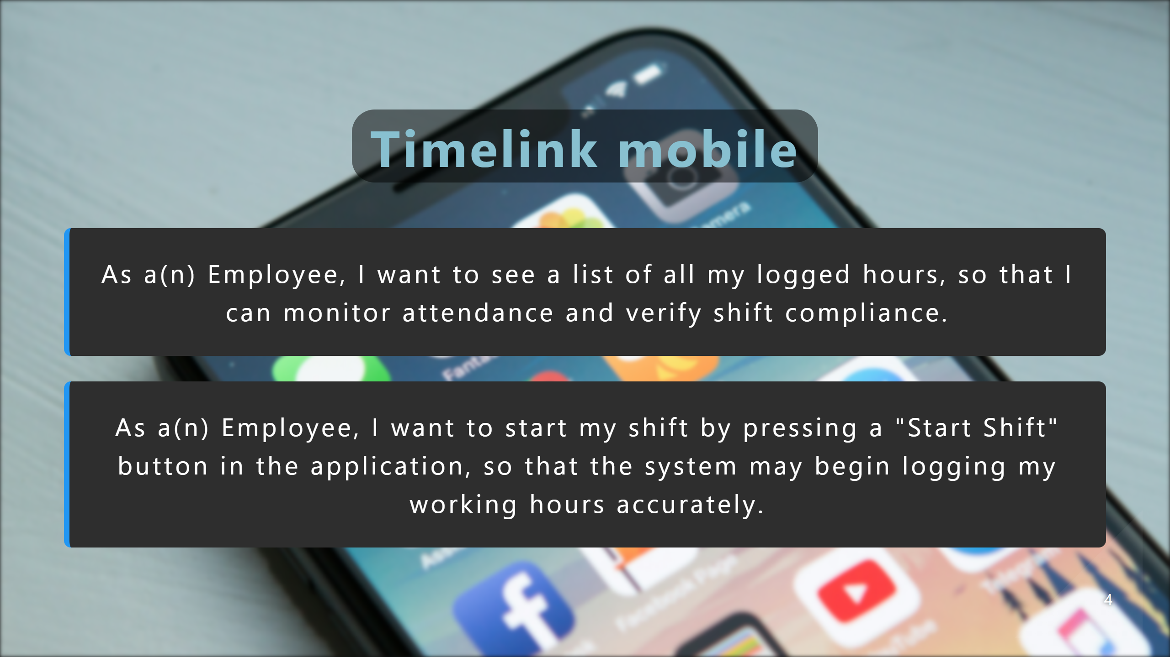
Notes:
Leonardo

Slide 5
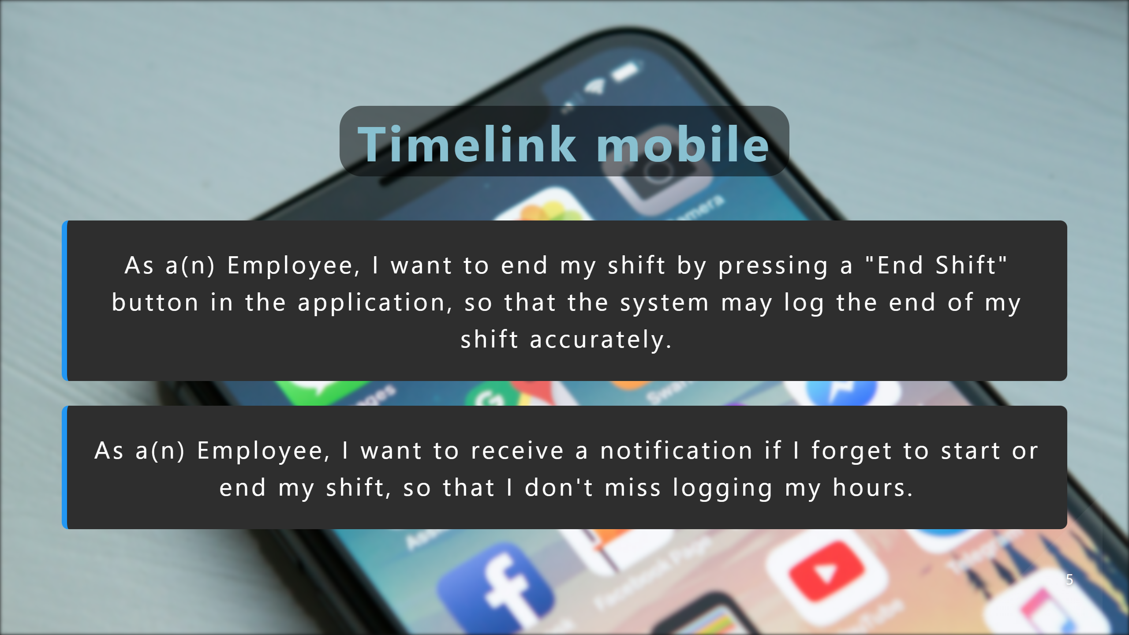
Notes:
Elvin

Slide 6
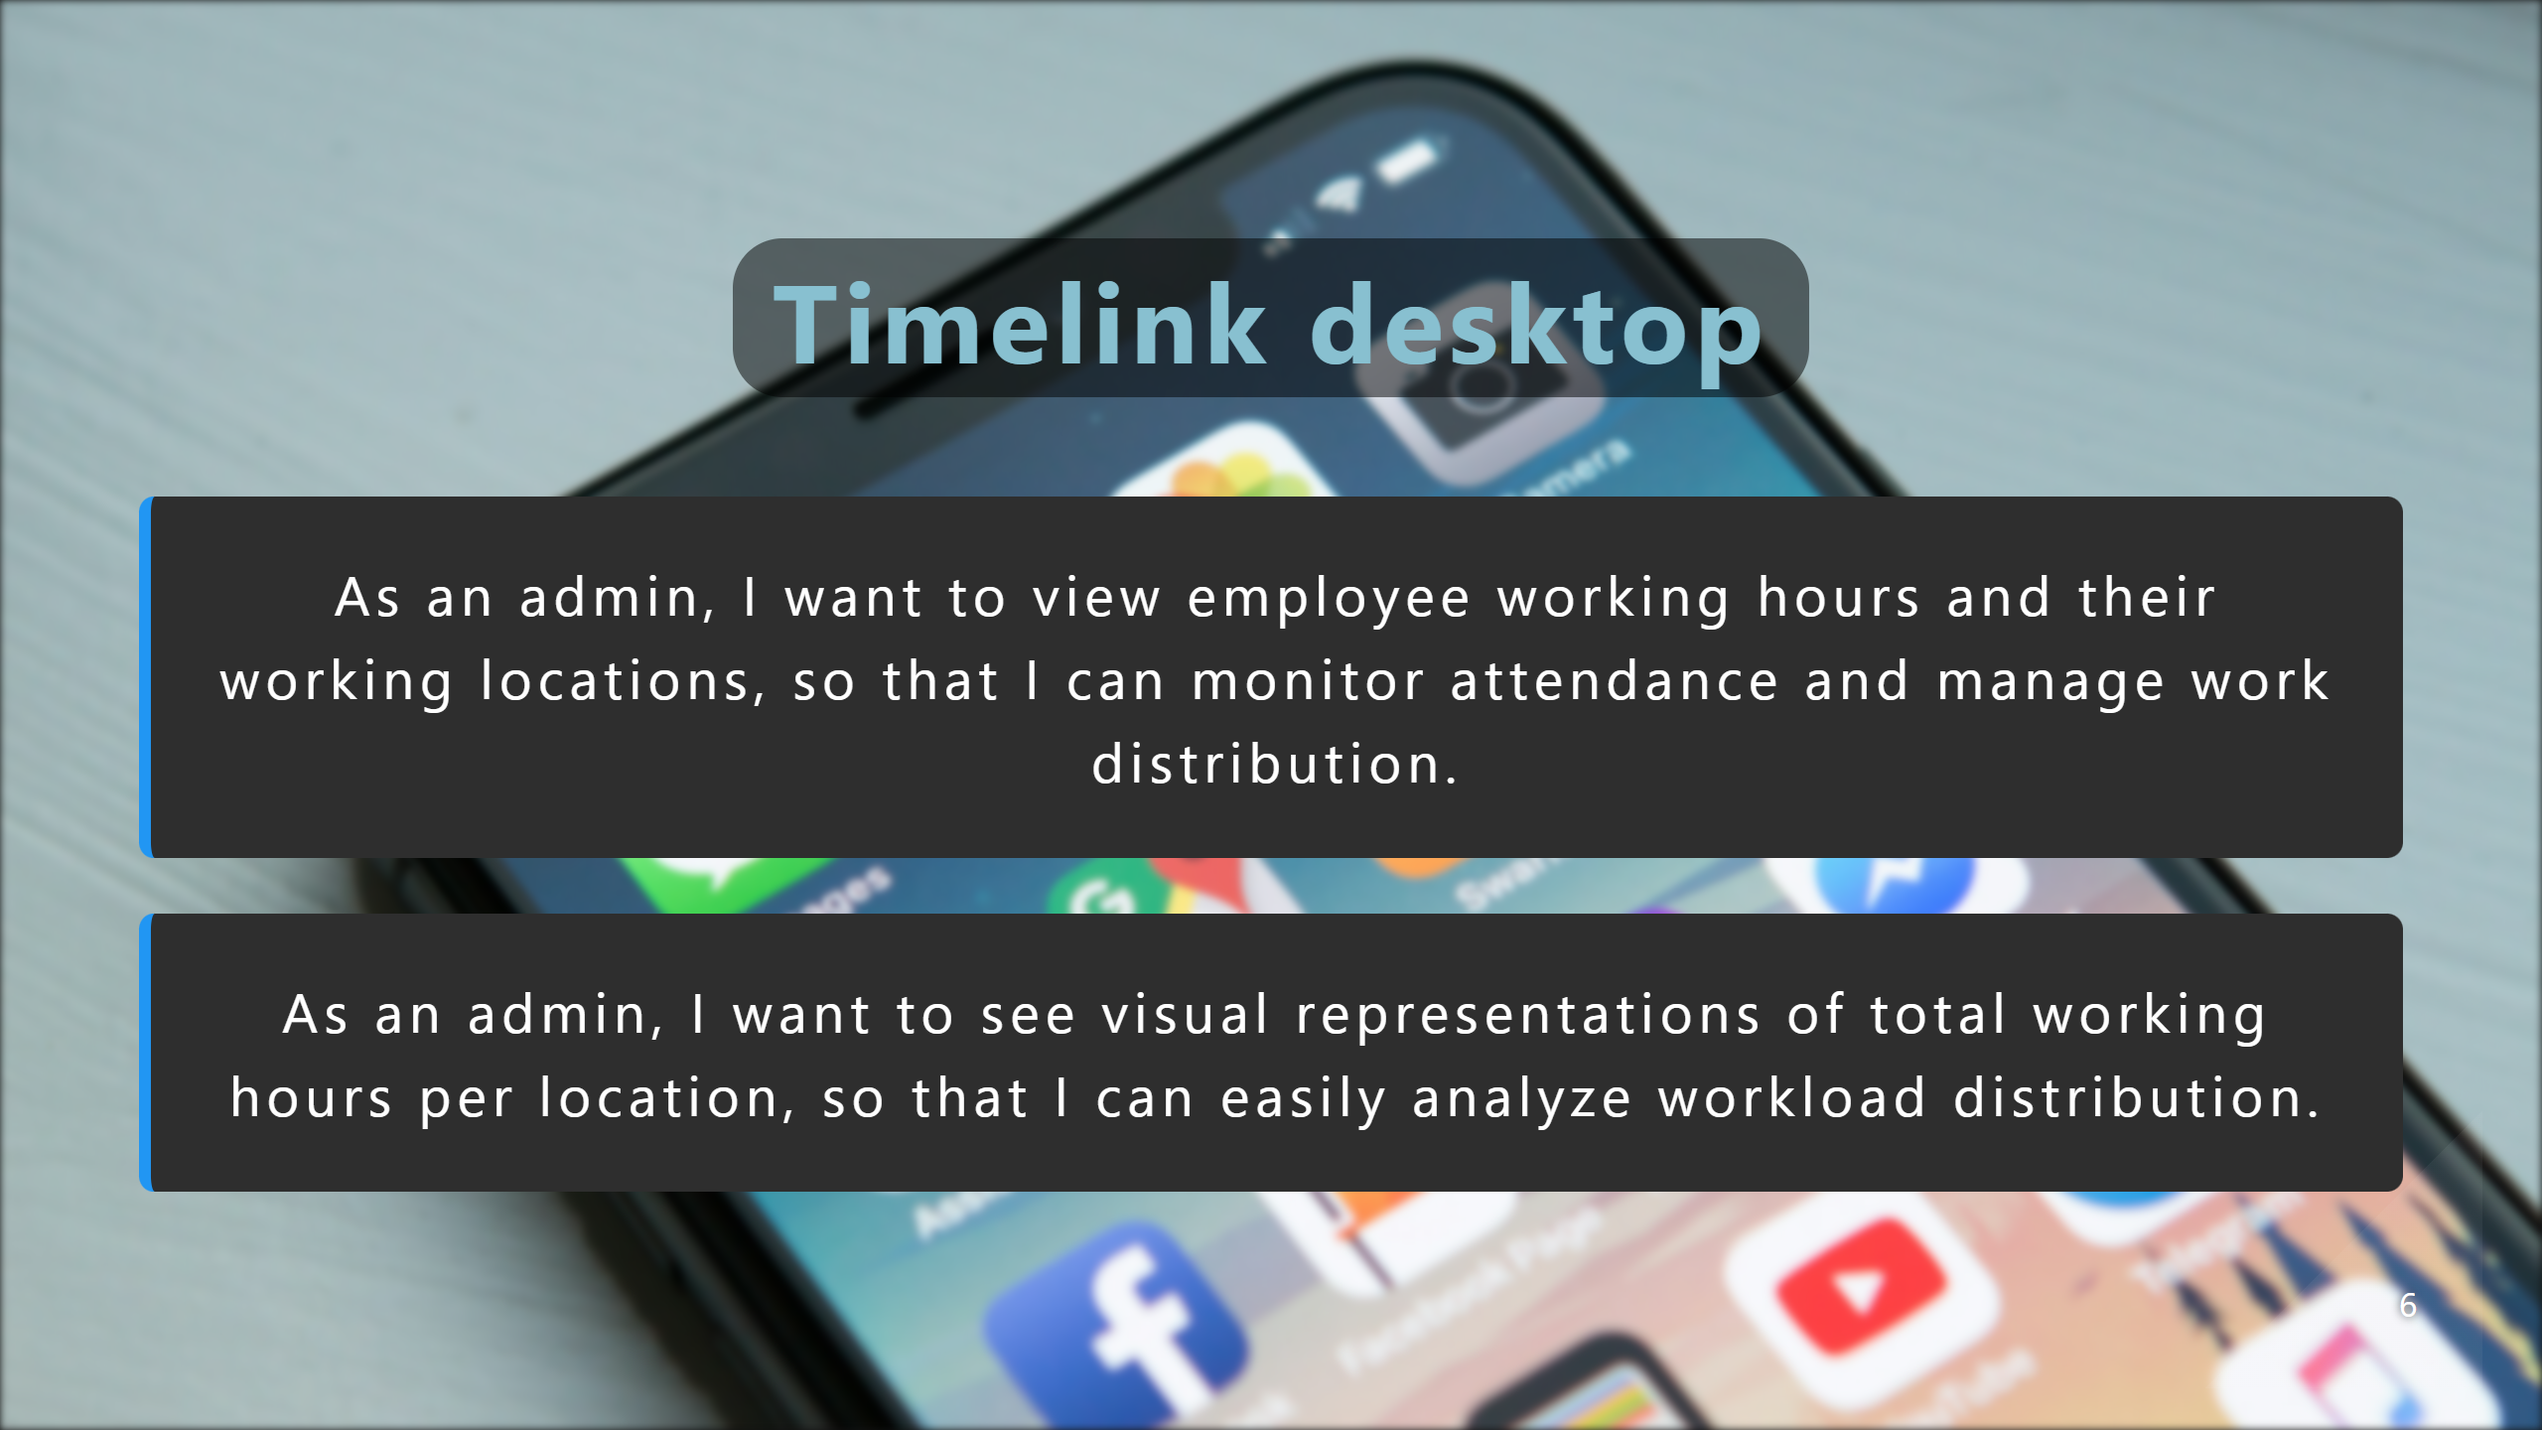
Notes:
Tomas

Slide 7
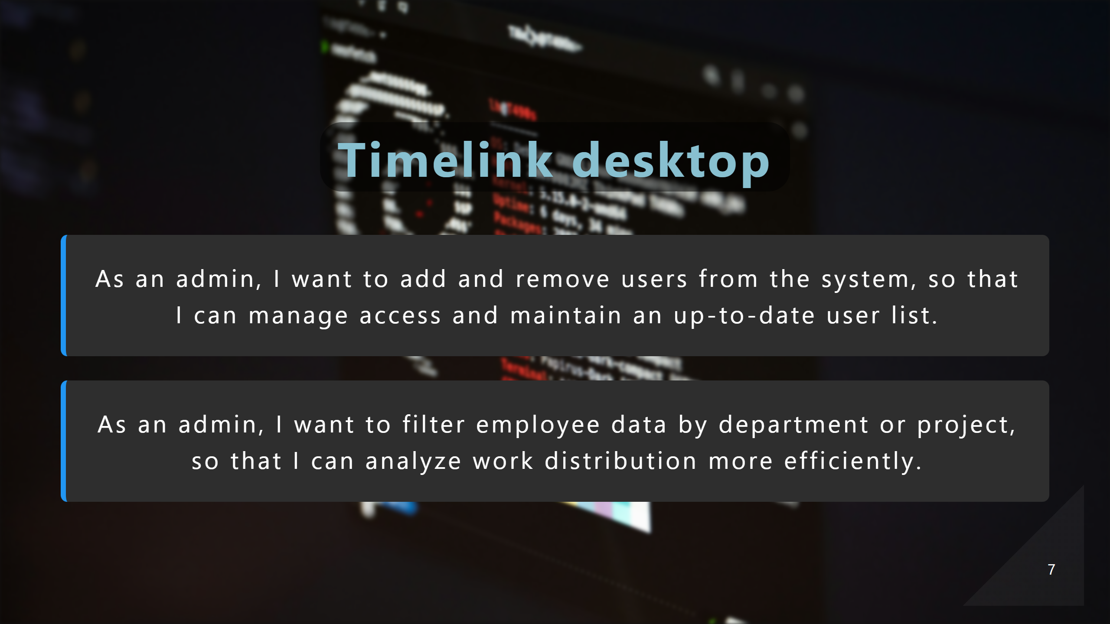
Notes:
Manon

Slide 8

Notes:
Andre

Slide 9
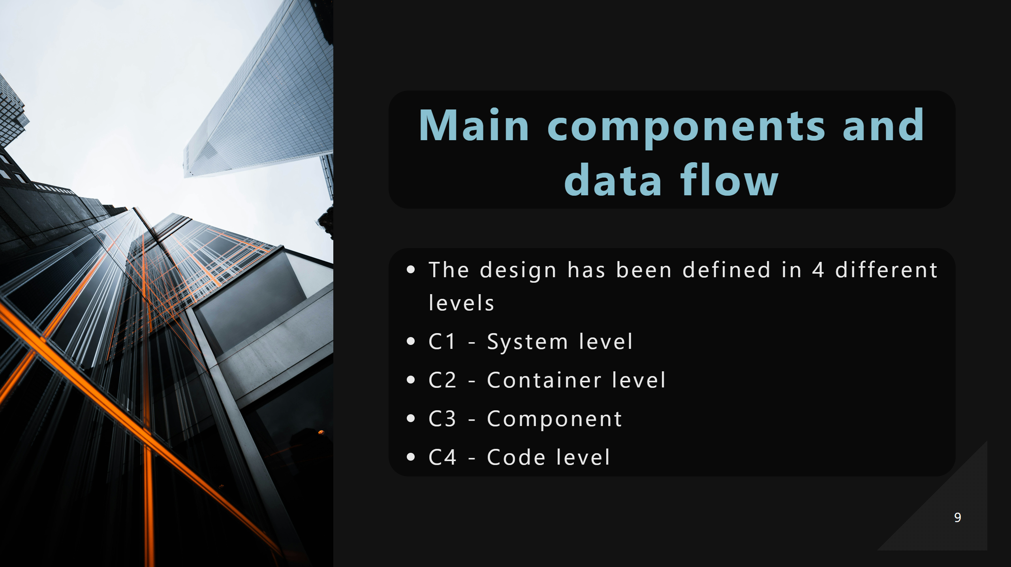
Notes:
Andre

Slide 10
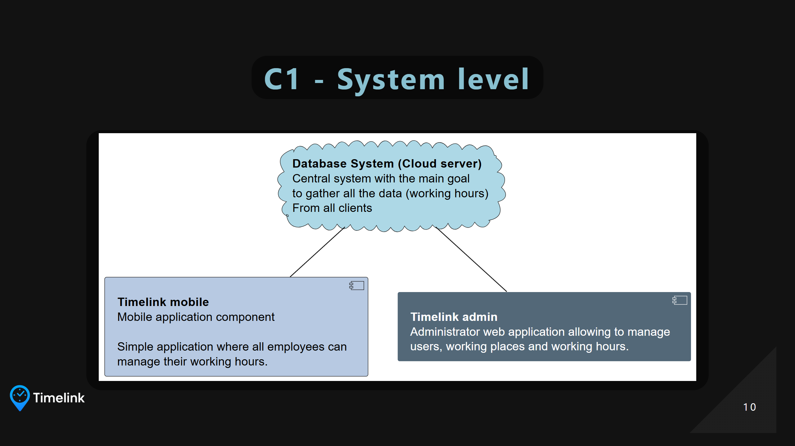
Notes:
Andre The project consists on three main deliverables - Database System -> The main brain of the system - Timelink mobile -> Simple app where all users shall insert their working hours - Timelink admin -> Administrator app for managers

Slide 11
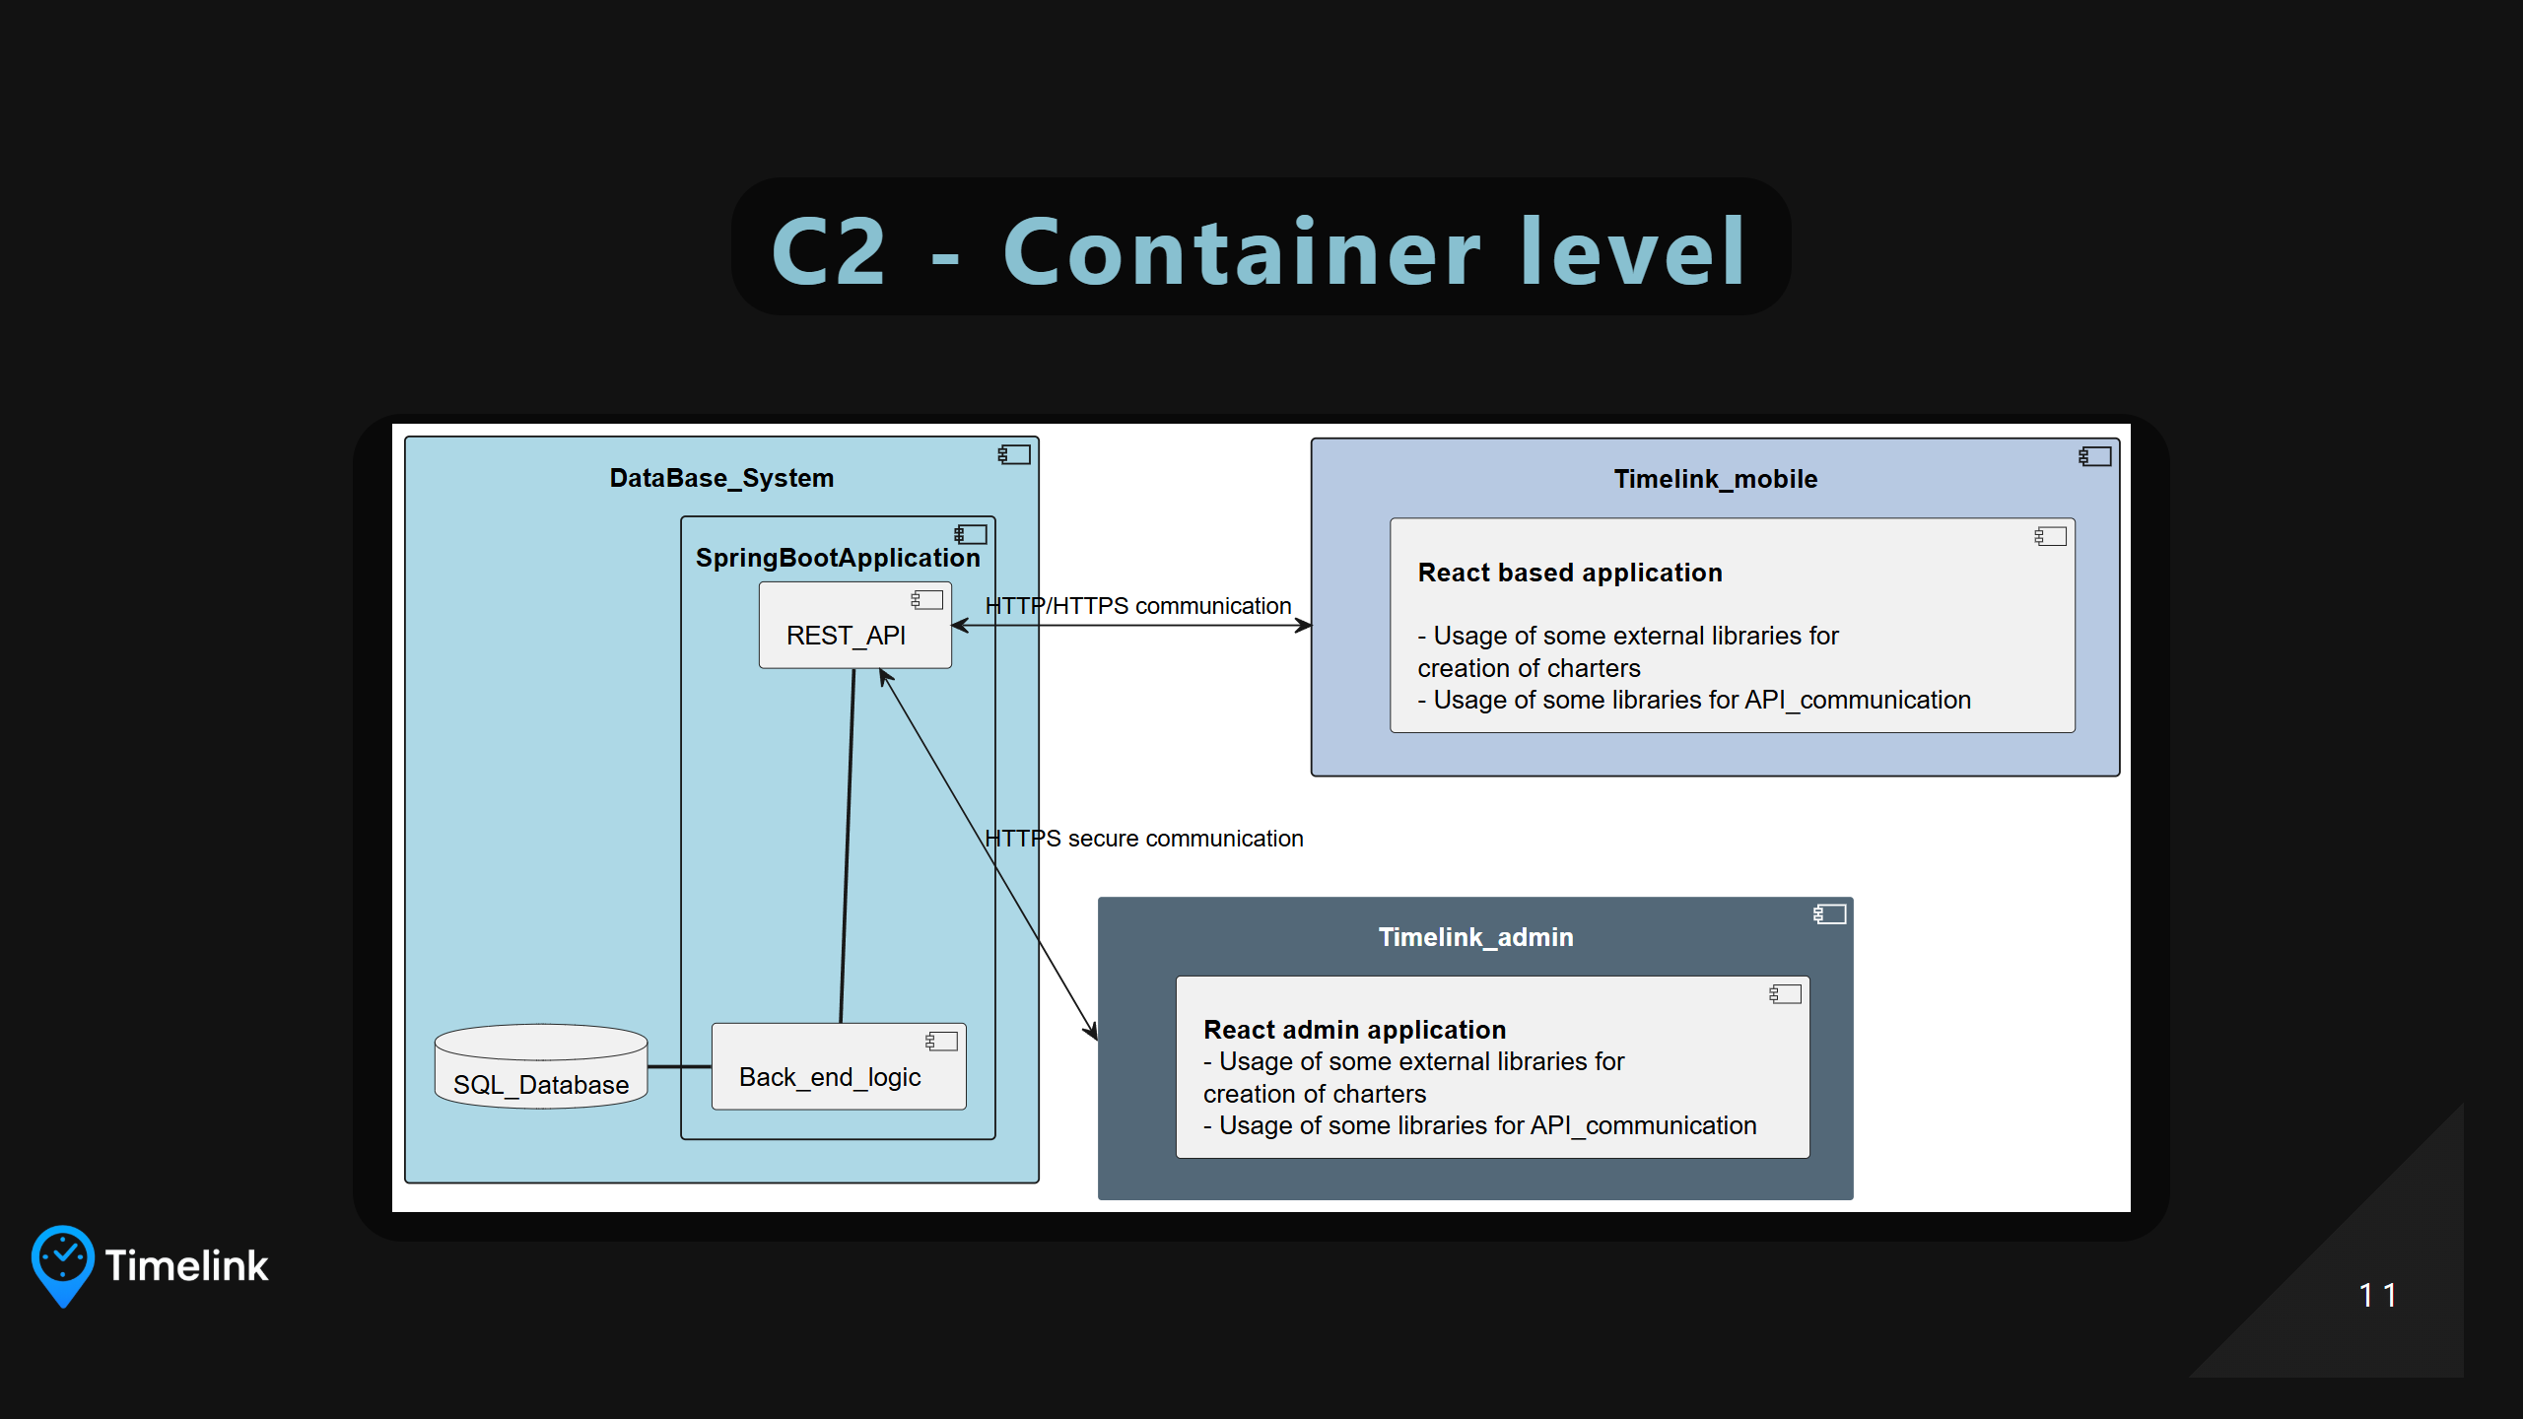
Notes:
Andre Explain each component together with each communication protocol

Slide 12
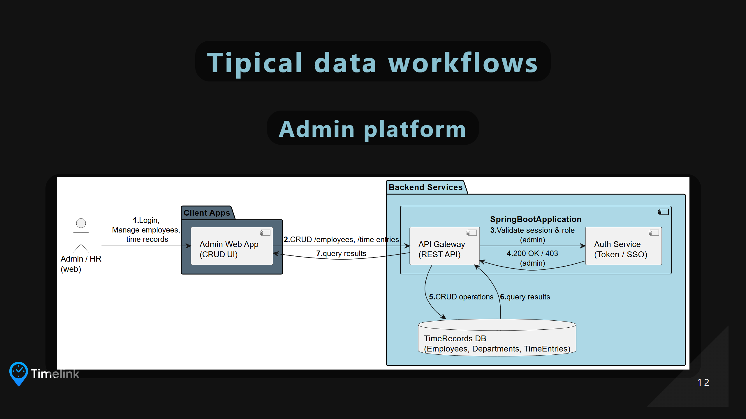
Notes:
Elvin

Slide 13
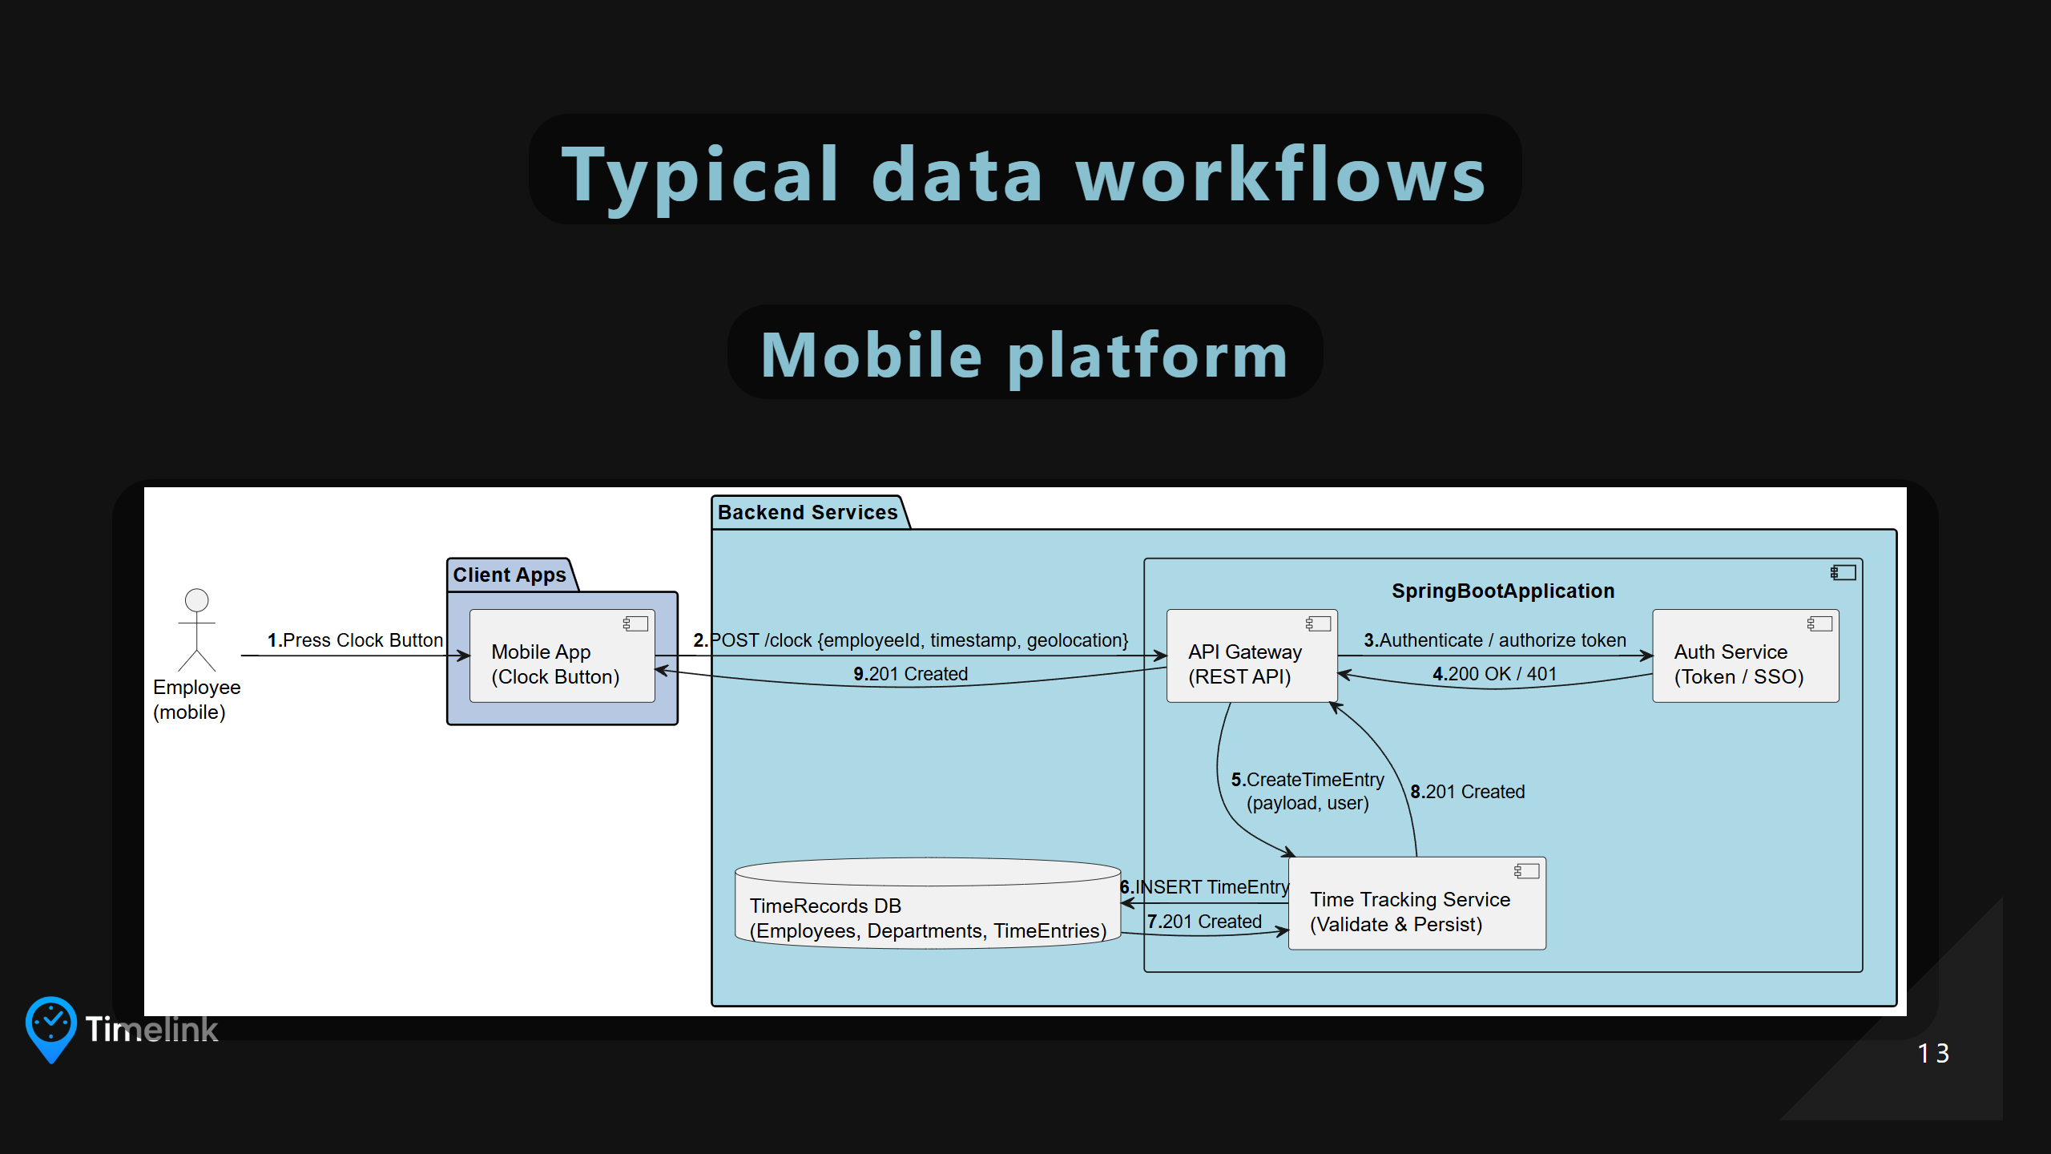
Notes:
Elvin

Slide 14

Notes:
Tomas

Slide 15
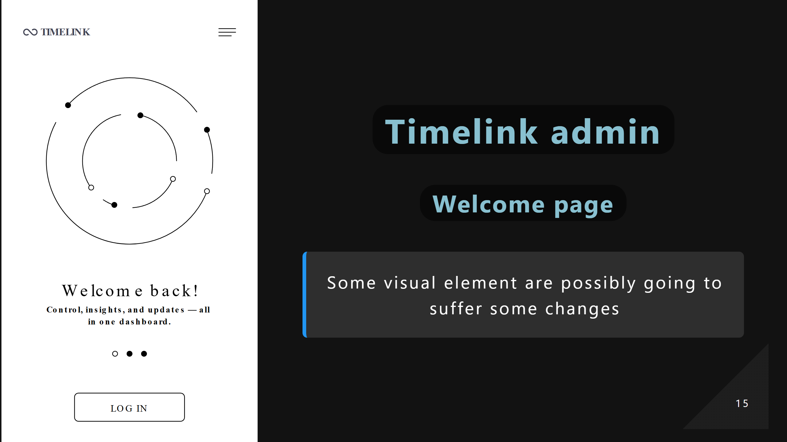
Notes:
Tomas

Slide 16
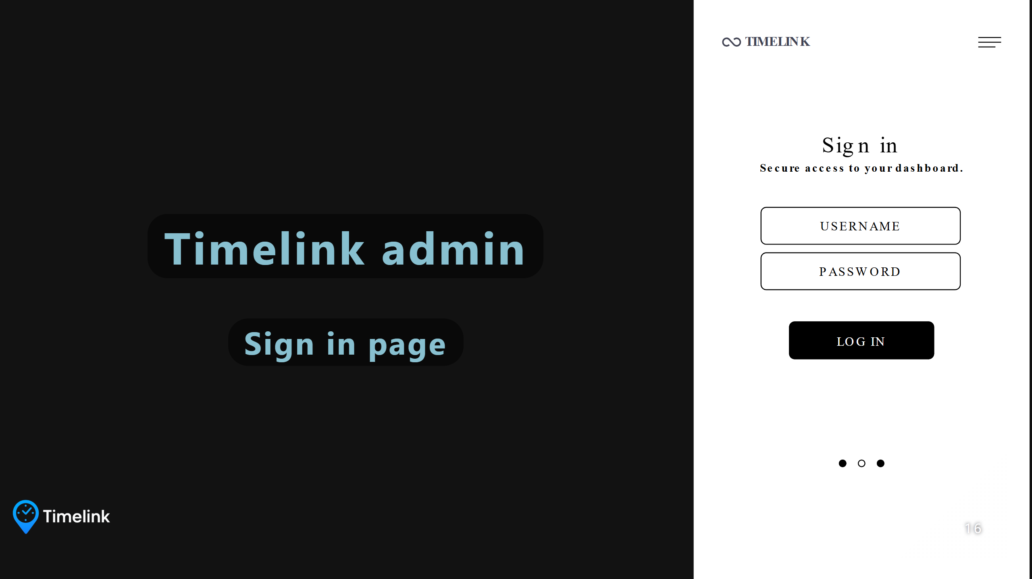
Notes:
Tomas

Slide 17
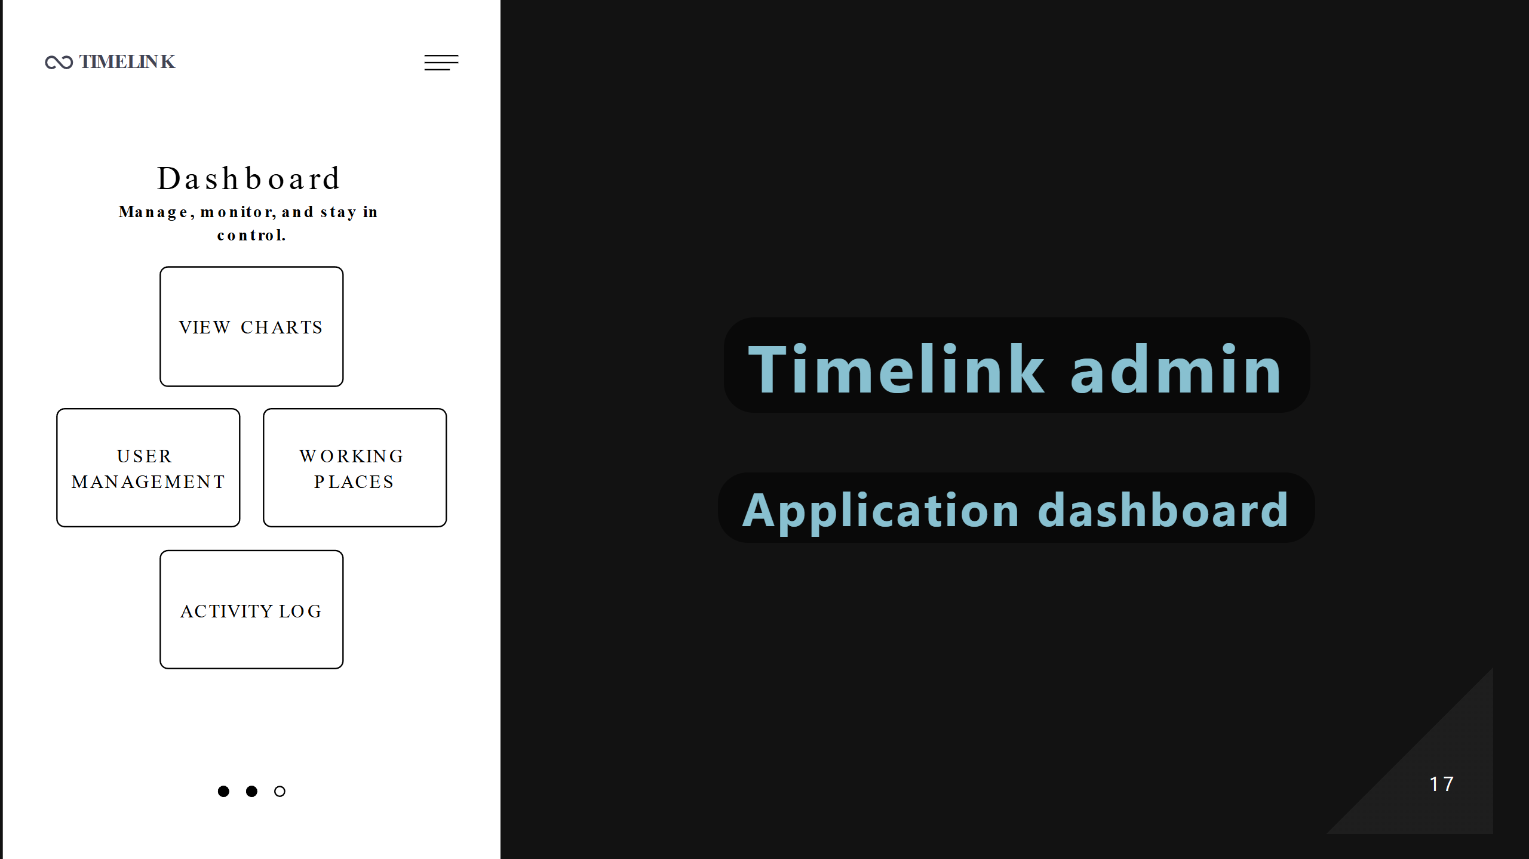
Notes:
Tomas

Slide 18
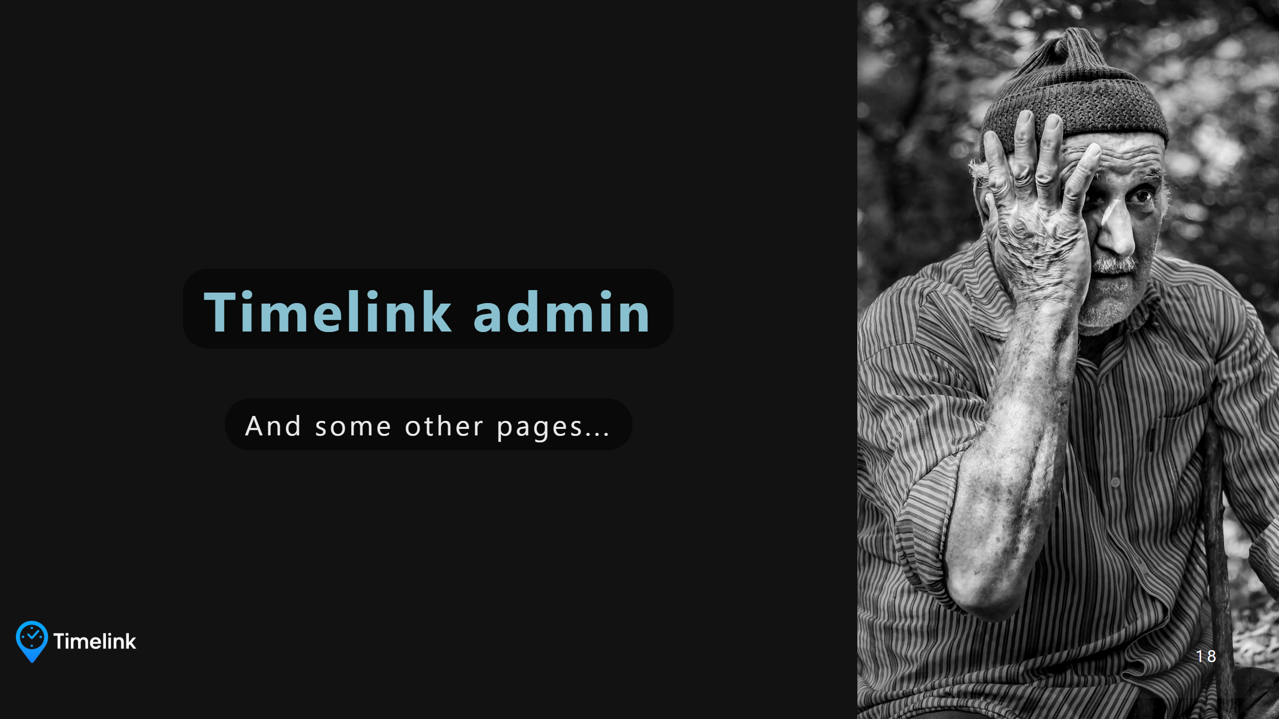
Notes:
Tomas

Slide 19
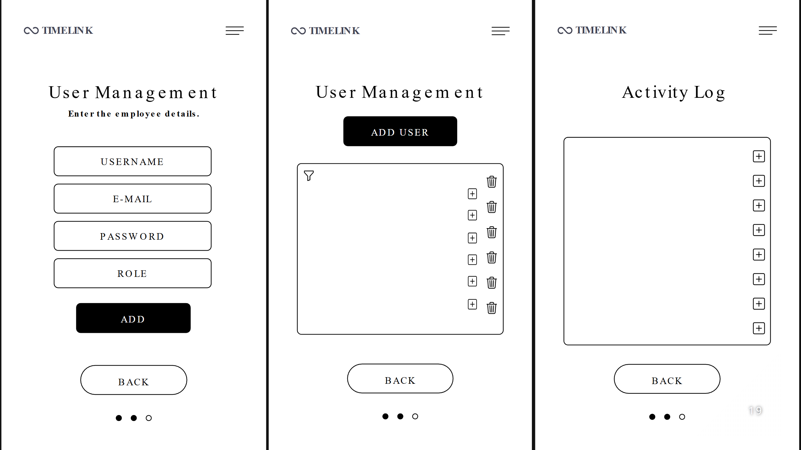
Notes:
Tomas

Slide 20

Notes:
Leonardo

Slide 21
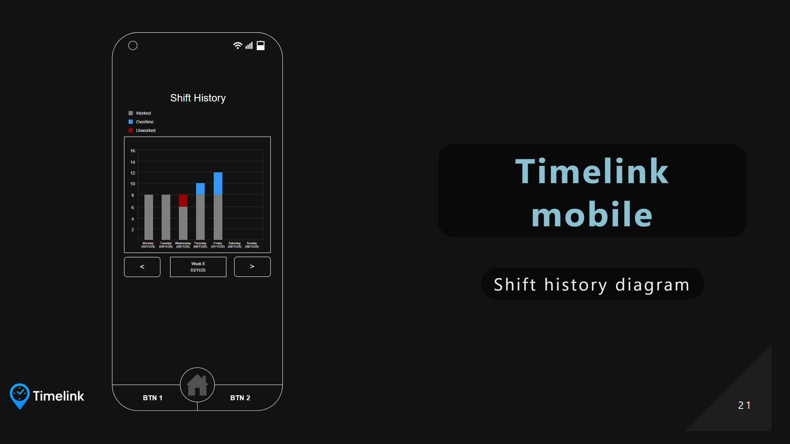
Notes:
Leonardo

Slide 22
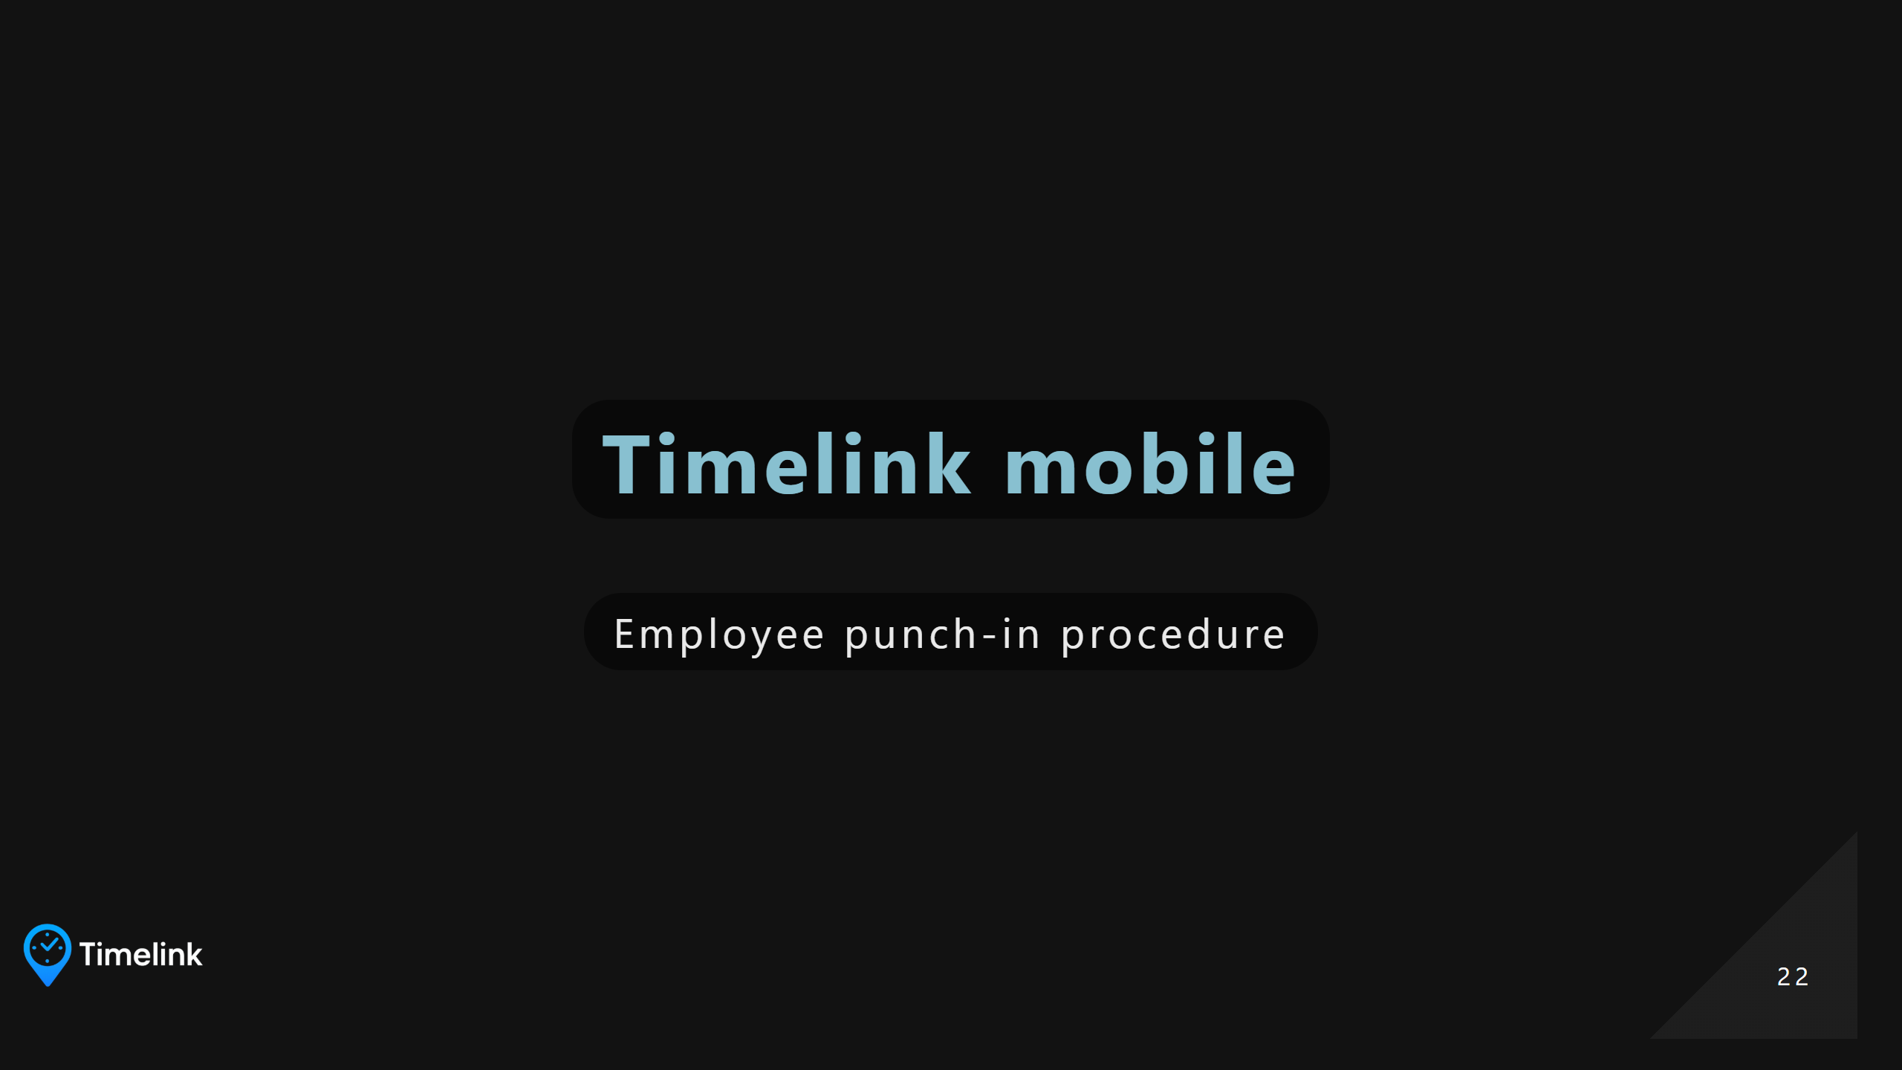
Notes:
Leonardo

Slide 23
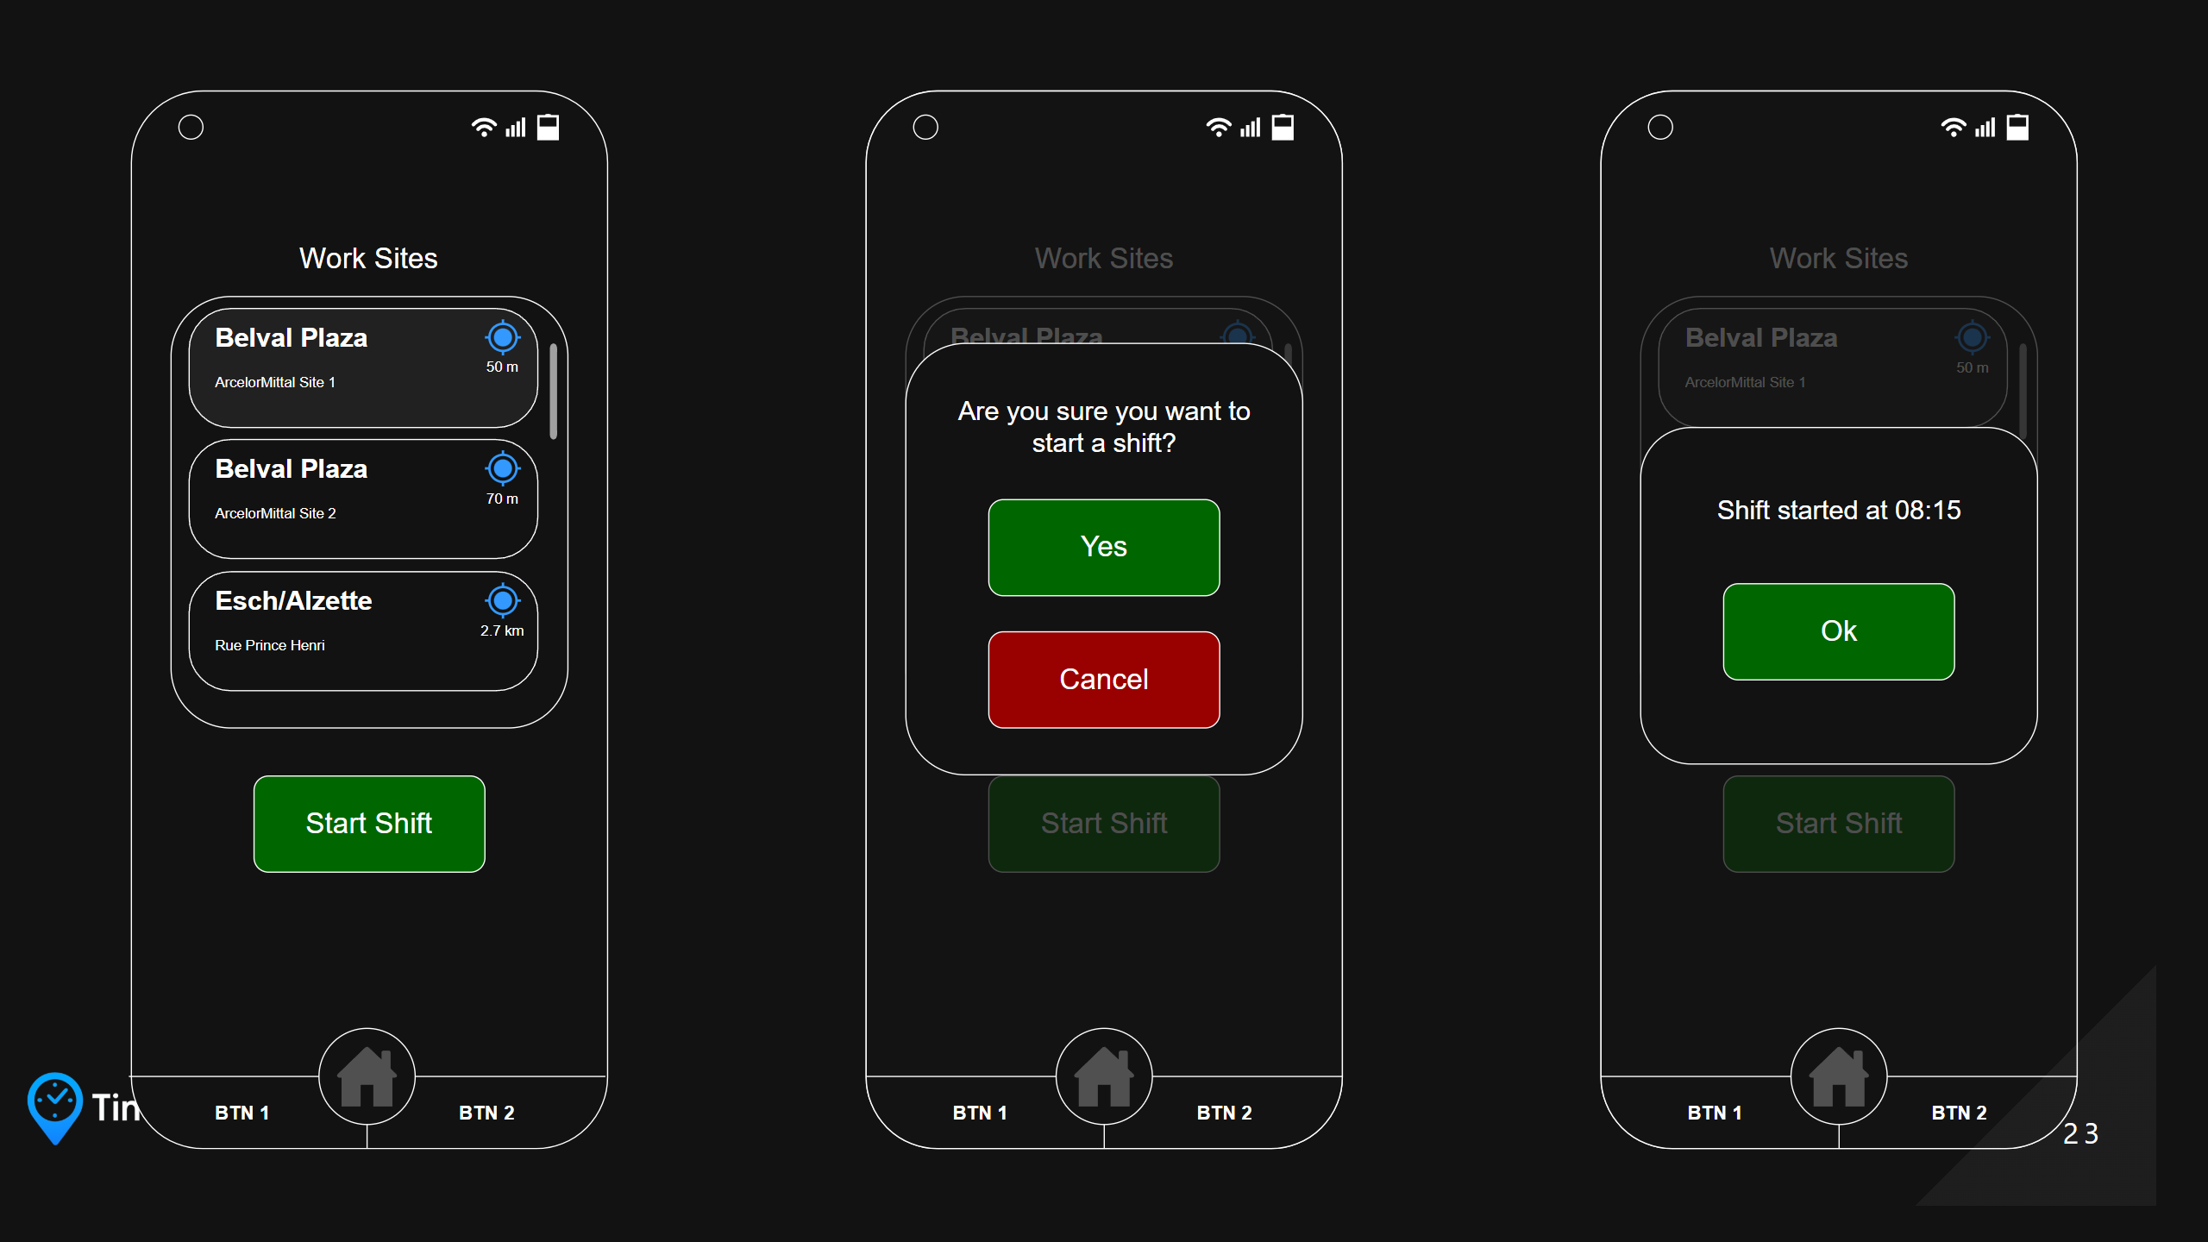
Notes:
Leonardo

Slide 24
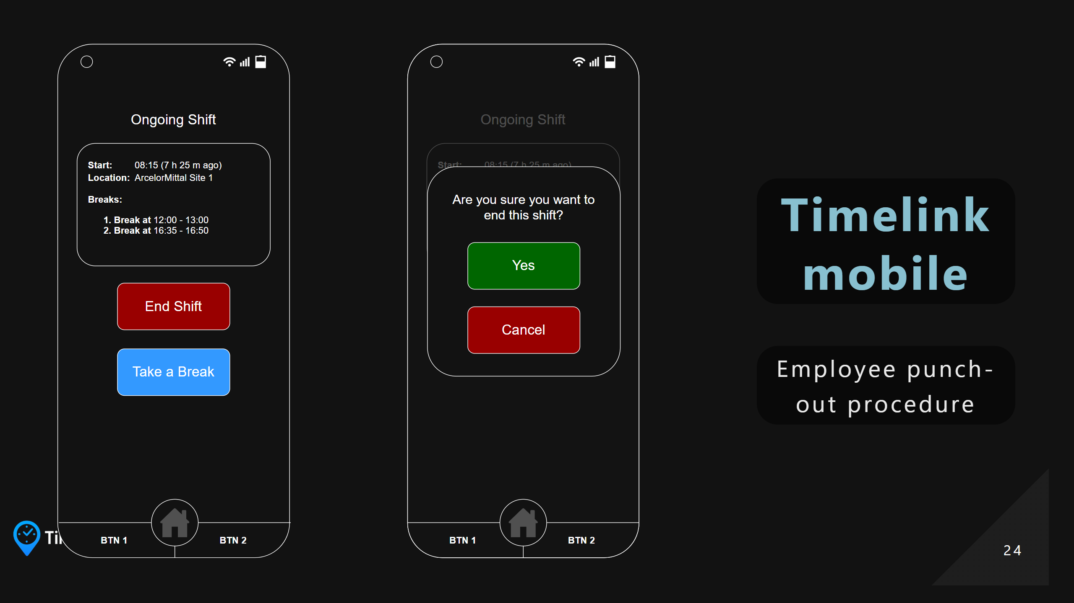
Notes:
Leonardo

Slide 25


Slide 26
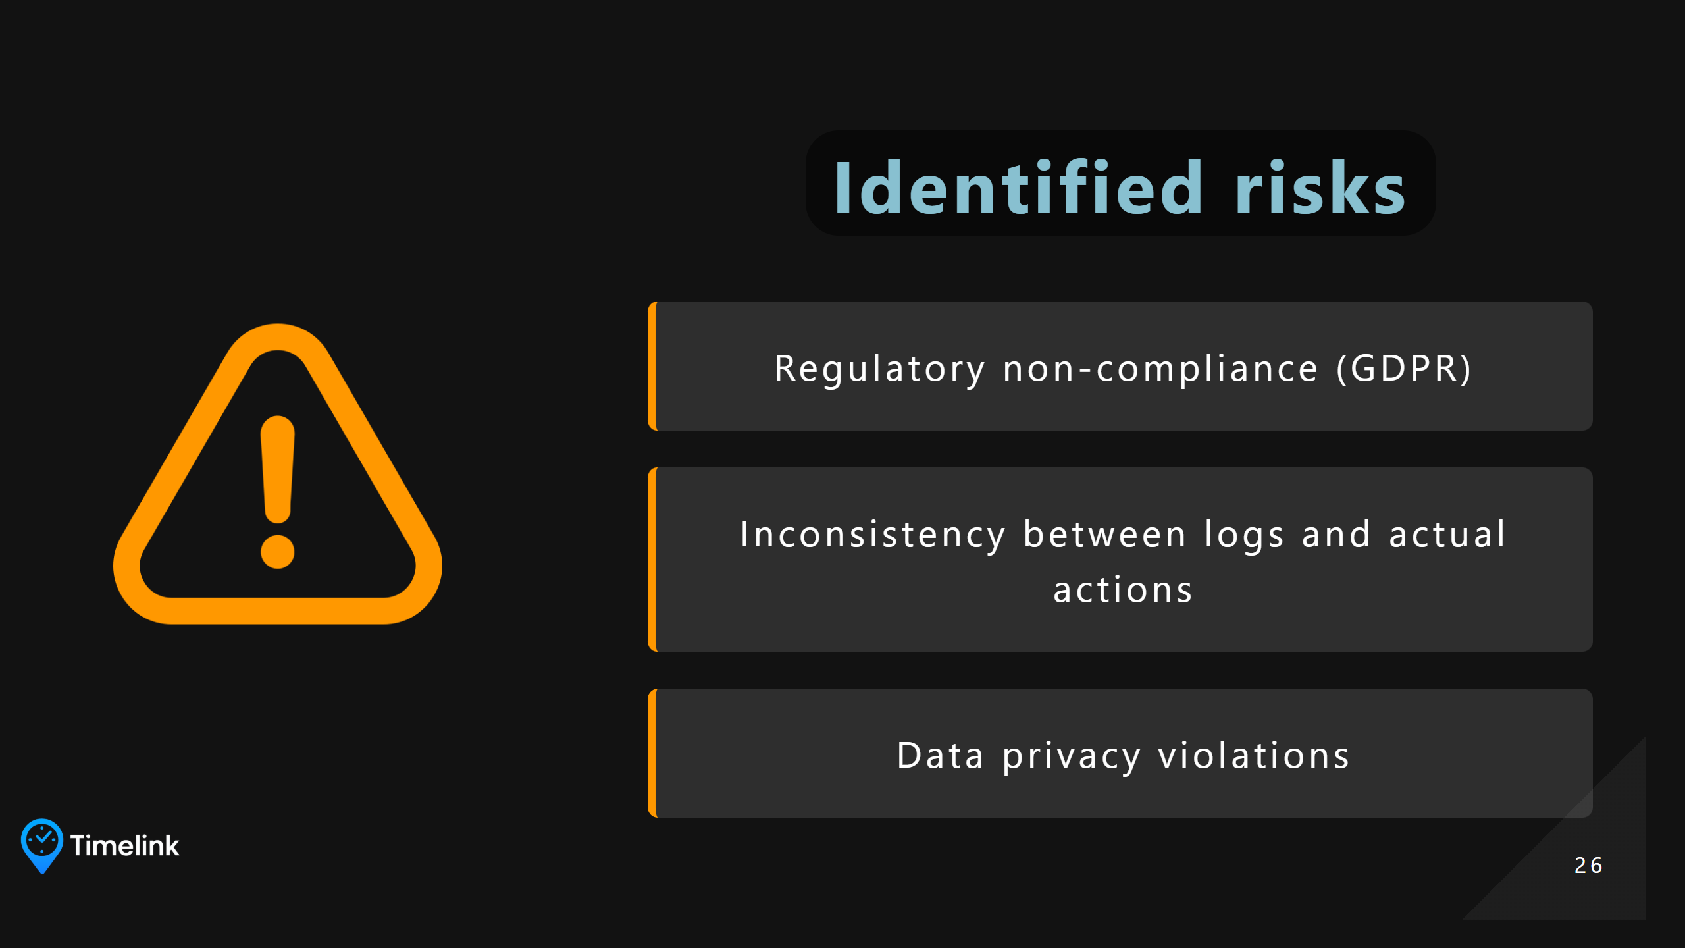
Notes:
Manon Manon - Regulatory non-compliance (GDPR); No compliant measures (hashing, session timeout); High, legal risk, reputation risk - Inconsistency between logs and actual actions;The logs do not accurately reflect the changes (delay or recording error).High

